Slide 1



Day 24
contact@anubhavtrainings.com
ABAP RESTFUL APPLICATION PROGRAMMING

Slide 2

Agenda – Day 24
Limitations of ABAP on Cloud
Describing AMDP with Use Case
Table function
Service Definition & Service Binding
BAS Introduction
Creating Fiori App on BAS using Service on CDS Model
Explanation of Flight Data Model

Slide 3

Limitation’s of ABAP on Cloud
It is an offering by SAP in SAP BTP platform as ABAP Platform as a service, which has limited capability.
https://blogs.sap.com/2019/08/20/its-steampunk-now/
We cannot use SAPGUI to connect to this system
We do not have control to install patches and add-on, snote
It is not an environment of any SAP ERP solutions
All the ABAP dictionary objects are marked as non-released
SAP’s actual product is S/4HANA, so all the classical extensions will be carried out in S4 itself.
You cannot create a program type of object
The AOC allows only usage of whitelisted abap statements, we cannot freely use every abap programming keyword.
Note : Eclipse environment can be used to connect to ABAP Environment in SAP Cloud platform

Slide 4
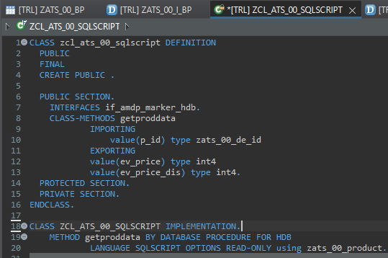
Describing AMDP
ABAP Managed Database Procedures (AMDP) are the preferred way for developing SAP HANA DB procedures on the ABAP platform. Since ABAP Managed Database Procedures are implemented as methods of a global ABAP class, the editing environment for AMDP is the ABAP class editor.
Requirement 1: Pass the product id, system should calculate the discounted price and return
actual and discounted price.
There are 2 types of SQL Script contains:-
Procedure - can have multiple return values
Function - always have one return value
Exercise
Create AMDP

Slide 5
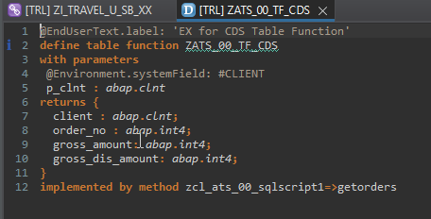
Creating Table Function
A CDS table function is defined using the ABAP CDS statement DEFINE TABLE FUNCTION and can be used as the data source in Open SQL read statements.
Each CDS table function includes the following components:
The actual CDS entity of the table function that is generated in the ABAP Dictionary
The CDS table function implementation (ABAP class library)
Requirement 2: return all the sales order no, amount (actual), discounted amount of sales orders]
Exercise
Create Table Function

Slide 6
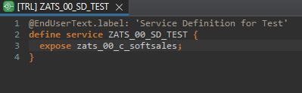
Service Definition
The service definition is a projection of the models and related behavior that you want to expose. In a service definition, you define the OData service to determine which CDS entities are part of the service. This service is then bound to a protocol and to either a UI technology or an A2X service by a service binding artifact. A service definition can be integrated in various protocols without any reimplementation.
Exercise
Service Definition

Slide 7
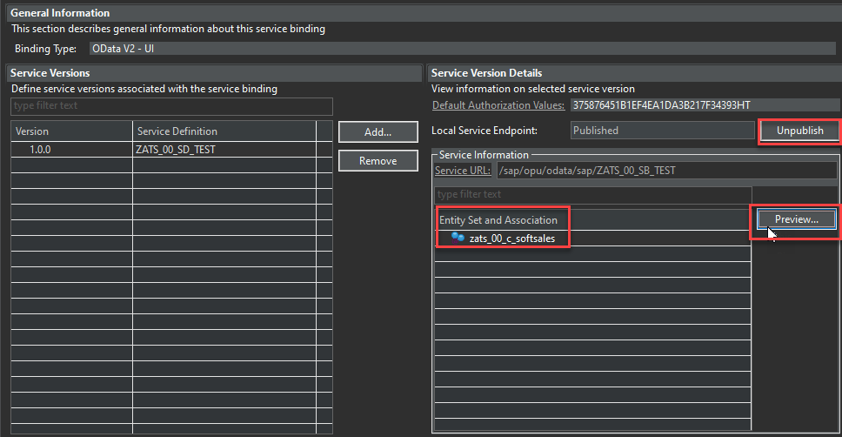
Service Binding
A service binding implements the protocol that is used for the OData service. It uses a service definition that projects the data models and their related behaviors to the service.

Slide 8
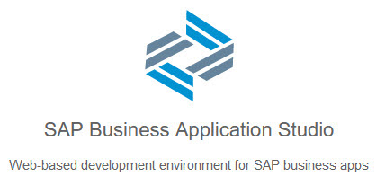
BAS Introduction
SAP Business Application Studio is a new SAP Business Technology Platform (BTP) service that offers a modern development environment tailored for efficient development of business applications for the SAP Intelligent Enterprise.
SAP Business Application Studio provides a tailor-made development environment for various development scenarios, such as SAP Fiori, SAP S/4HANA extension, and Workflow. With each of these scenarios, you can create different types of applications.
These tools cover the end-to-end development cycle:
Clone an existing project with a Git client or create new project using templates.
Use editors for SAP-specific technologies.
Easily test your application on your dev space while consuming services from remote sources.
Build and deploy the application as a multitarget application (MTA).

Slide 9
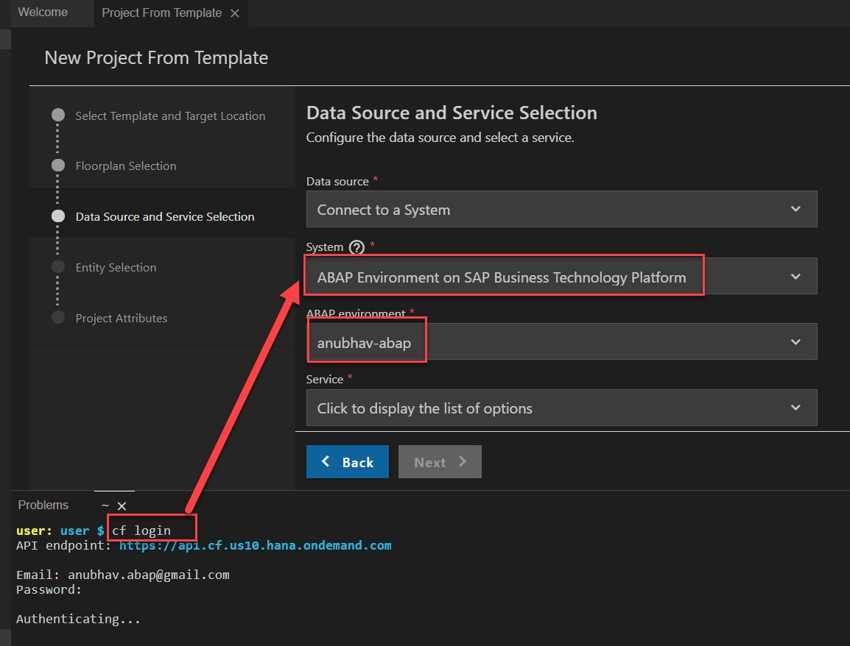
Creating Fiori App on BAS
Creating Fiori App on BAS Using Service on Top of CDS Model.
First Login Cloud Foundry ( cf login ).
Select System ABAP Environment on SAP BTP.

Slide 10

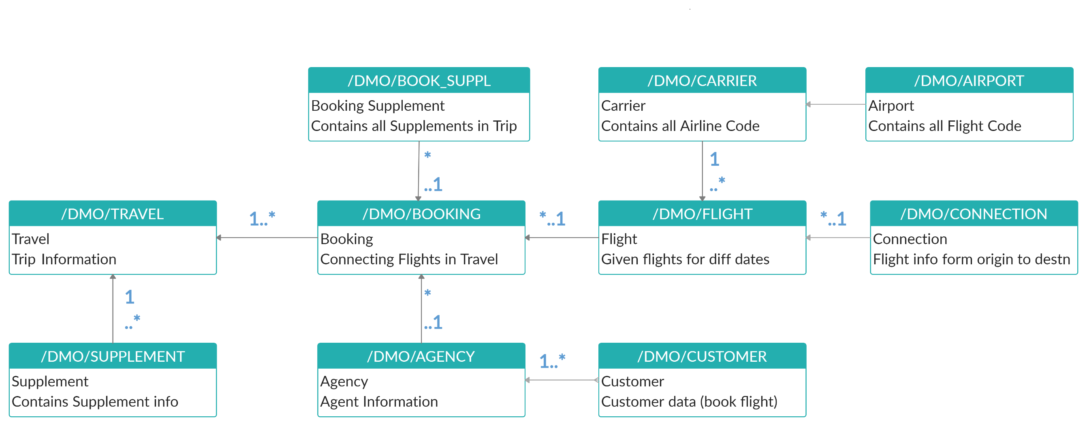
Explanation of Flight Data Model
If Data is not found in these Table’s please execute Data Generator Class “/dmo/cl_flight_data_generator”

Slide 11
Important Table’s
CDS Views on these table for ease of access
Database tables
Represents entire aviation tourism
/DMO/CARRIER– Contains all the airline codes
I_Currency
CDS view to access currency codes
/DMO/AGENCY
Agent information website/person who helps
/DMO/CONNECTION– FLIGHT infor from origin to destination
I_Country
Country codes
/DMO/TRAVEL
Trip information
/dmo/flight– given flight for diff. dates
/DMO/CUSTOMER
Customer data who willing to book flights
/DMO/BOOKING
Connecting flights in whole travel

Slide 12

End of Day 24
Trainer: Anubhav Oberoy

Slide 13

Trainer: Anubhav Oberoy

Slide 14
THANK YOU
If you cannot do
great things, do small things in a great way.
Anubhav Oberoy
https://www.anubhavtrainings.com

Slide 15


We’re committed to empower you to be
Most Desirable Resource
through powerful training solutions.
We build the workforce of the future.
250+
Corporate Clients
30,000+
Learners Trained
25000+
Learners Placed
FREE WEBINARS
Sign up for free webinars with industry experts every fortnight!
Enroll Now!
Contact us today!
https://anubhavtrainings.com/

Slide 16




More from AnubhavTrainings.com

